Slide 1
ANALYZING FUEL ECONOMY OF VARIOUS VEHICLES

Slide 2
TABLEAU WORKSHEETS

Slide 3
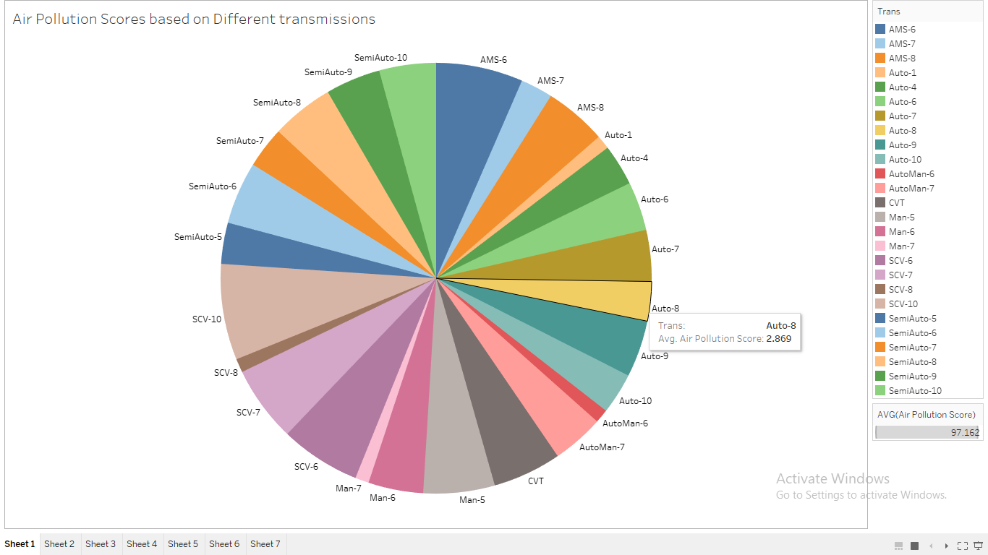

Slide 4
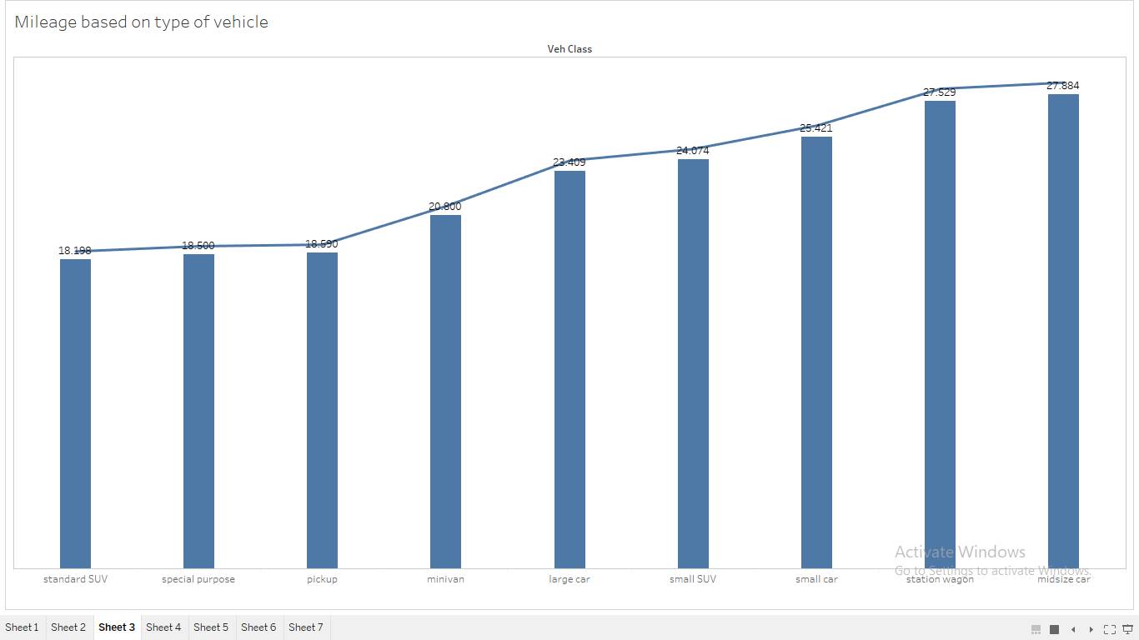

Slide 5
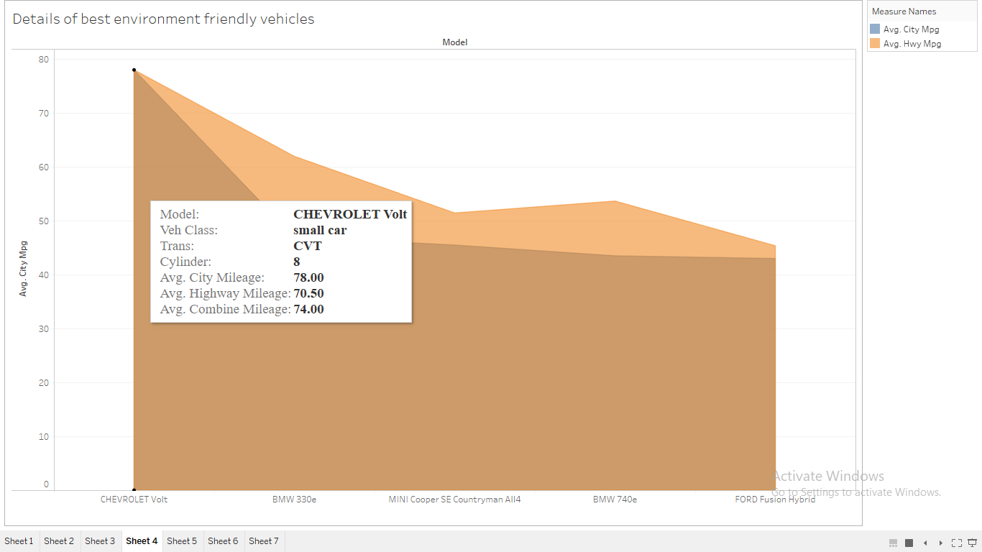

Slide 6
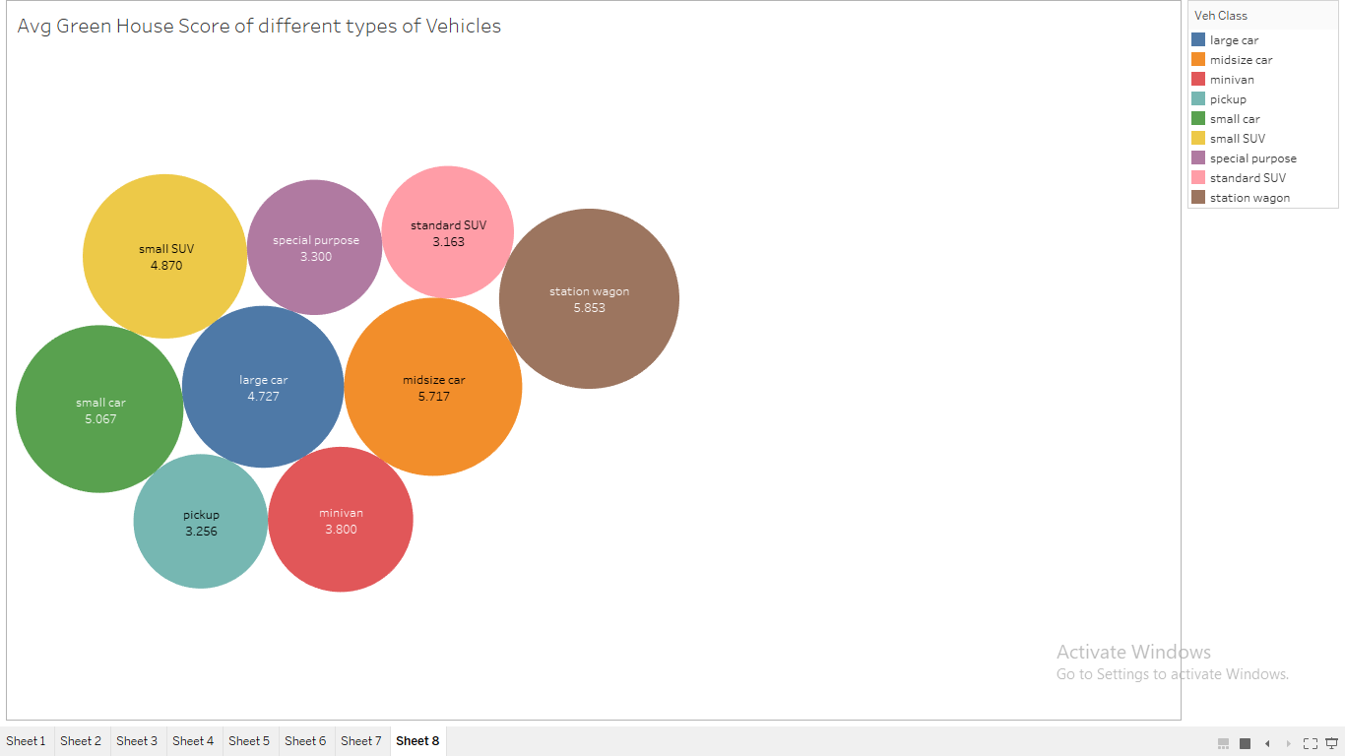

Slide 7
DASHBOARDS
Click Here

Slide 8
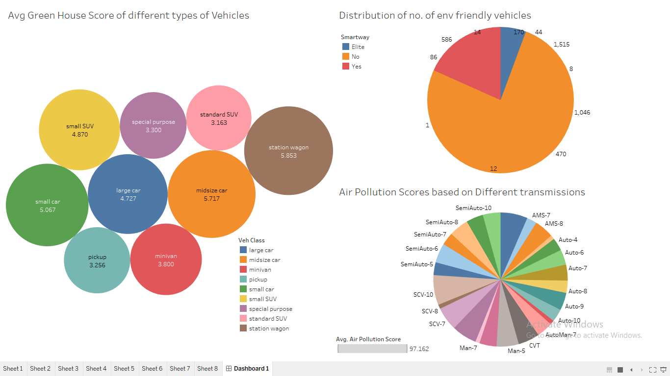

Slide 9
